Slide 1
Message Passing Programming
6 Hours

Slide 2
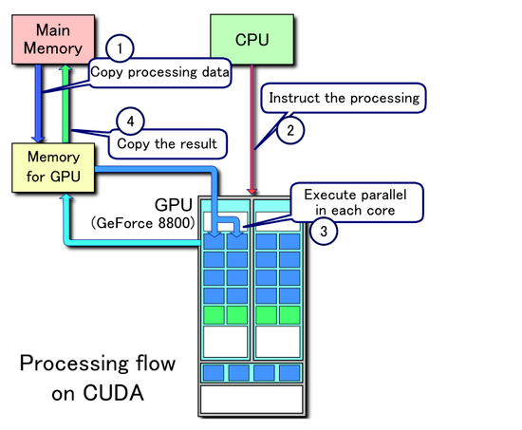

Slide 3
Topics covered:
Introduction to Message Passing Interface (MPI)
Message Passing Model
MPI Basic Datatypes and Functions
Point-to-point Communication
Collective Communication
Benchmarking Parallel Performance
MPI Error Handling Functions

Slide 4
Introduction to MPI
The MPI standard is the most popular message-passing library interface specification supporting parallel programming
MPI is a message-passing parallel programming model, in which data is moved from the address space of one process to that of another process through cooperative operations on each process
MPI is not a programming language, and all MPI operations are expressed as functions, subroutines, or methods used by C, C++, Fortran-77, and Fortran-95 etc which are part of MPI standard

Slide 5
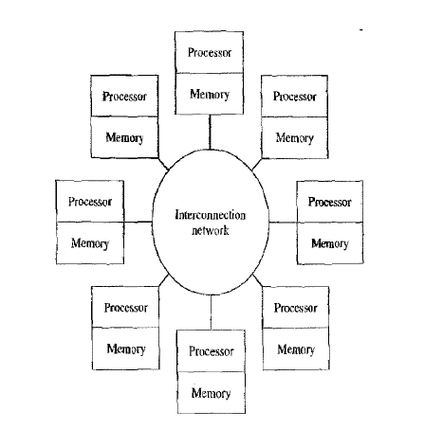
Message Passing Model

Slide 6
Message Passing Model
Message-passing model
The underlying hardware is assumed to be a collection of processors, each with its own local memory
A processor has direct access only to the instructions and data stored in its local memory
However, an interconnection network supports message passing between processors
Processor A may send a message containing some of its local data values to processor B, giving processor B indirect access to these values
The existence of the interconnection network provides an implicit communication channel between every pair of processes

Slide 7
Message Passing Model
Message-passing model
The user specifies the number of concurrent processes when the program begins, and the number of active processes remains constant throughout the execution of the program
Every process executes the same program, but because each one has a unique ID number, different processes may perform different operations on the same program
In a message-passing model, processes pass messages both to communicate and to synchronize with each other

Slide 8
Advantages of message-passing model
Message-passing programs run well on a wide variety of MIMD architectures
They are a natural fit for multicomputers, which do not support a global address space
The MPI programs tend to exhibit high cache hit rates when executing on multiprocessors, leading to good performance
Debugging MPI programs is simpler than debugging shared-variable programs. Since each process controls its own memory, it is not possible for one process to accidentally overwrite a variable controlled by another process, a common bug in shared-variable programs.

Slide 9
Key concepts of MPI programming
Used to create parallel programs
Processors communicate using message passing via calls to message passing library routines
Programmers “parallelize” programs by adding message calls between manager process and worker process
No process can be created or terminated in the middle of program execution
All process stay alive till the program terminates
Each processor has a local memory to which it has exclusive access
The MPI programs tend to exhibit high cache hit rates when executing on multiprocessors, leading to good performance
The number of processes is fixed when starting the program

Slide 10
MPI Naming Conventions, Basic Datatypes and Routines
MPI Naming Conventions
The names of all MPI entities (routines, constants, types, etc.) begin with MPI_ to avoid conflicts
Example: MPI_Init(&argc, &argv)
All MPI constants are strings of capital letters and underscores beginning with MPI_
Example: MPI_COMM_WORLD

Slide 11
Predefined data types for MPI
MPI Datatype C-Data type
MPI_CHAR signed char
MPI_SHORT signed short int
MPI_INT signed int
MPI_LONG signed long int
MPI_LONG_LONG_INT long long int
MPI_UNSIGNED_CHAR unsigned char
MPI_UNSIGNED_SHORT unsigned short int
MPI_UNSIGNED unsigned int
MPI_UNSIGNED_LONG unsigned long int
MPI_UNSIGNED_LONG_LONG unsigned long long int
MPI_FLOAT float
MPI_DOUBLE double
MPI_LONG_DOUBLE long double
MPI_WCHAR wide char
MPI_PACKED special data type for packing
MPI_BYTE single byte value

Slide 12
MPI routines
MPI routines are implemented as functions which return the exit status of the function call
int ierr;
...
ierr = MPI_Init(&argc, &argv);
The error code returned is MPI_SUCCESS if the routine ran successfully or else the integer returned has an implementation-dependent value indicating the specific error

Slide 13
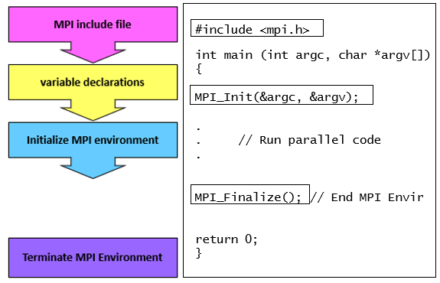
General MPI Program Structure

Slide 15
Basic Environment
MPI_Init(&argc, &argv)
Must be called in every MPI program
It should be the first MPI function call made by every MPI process
It initializes MPI environment
Can be used to pass command line arguments to all
MPI_Finalize()
It terminates MPI environment after releasing all the held up resources
It should be the last MPI function call

Slide 16
Communicators & Rank
1
3
4
dest
1
2
0
4
0
0
Comm1
5
2
1
3
Comm2
1
2
3
6
source
5
2
0
Communicator
MPI_COMM_WORLD
MPI_COMM_WORLD
When MPI has been initialized, every active process becomes a member of a communicator called MPI_COMM_WORLD
A communicator is an object that provides the environment for message passing among processes
MPI_COMM_WORLD is the default communicator that you get "for free”
However, you can create your own communicators if you need to partition the processes into independent communication groups

Slide 17
Communicators & Rank
What is rank of a process??
Processes within a communicator are always ordered
The rank of a process is its position in the overall order
In a communicator with p processes, each process has a unique rank (ID number) between 0 and p – 1
A process may use its rank to determine which portion of a computation and/or a dataset it is responsible for

Slide 18
Communicators & Rank
int my_rank, size;
MPI_Comm_rank(MPI_COMM_WORLD, &my_rank)
A process calls this function to determine its rank within a communicator
MPI_Comm_size(MPI_COMM_WORLD, &size)
A process calls this function to determine the total number of processes in a communicator
int my_rank, size; MPI_Init(&argc,&argv); MPI_Comm_rank(MPI_COMM_WORLD,&my_rank);
MPI_Comm_size(MPI_COMM_WORLD,&size);

Slide 19

Hello World for MPI
#include <mpi.h> #include<stdio.h>
int main (int argc, char *argv[])
{ int rank, size;
MPI_Init (&argc, &argv); //initialize MPI library
MPI_Comm_size(MPI_COMM_WORLD, &size); //get number of processes
MPI_Comm_rank(MPI_COMM_WORLD, &rank); //get my process id
printf("Processor %d of %d: Hello World!\n", rank, size);
MPI_Finalize(); //MPI cleanup
return 0;
}
MPI_Init(int *argc, char ***argv);

Slide 20
Hello World for MPI
Running this code on four processors will produce a result like:
mpicc –o prg1 program1.c
mpirun -n 4 prg1
Processor 2 of 4: Hello World!
Processor 1 of 4: Hello World!
Processor 3 of 4: Hello World!
Processor 0 of 4: Hello World!
Each processor executes the same code, including probing for its rank and size and printing the string.
The order of the printed lines is essentially random!

Slide 21
Point-to-point Communication in MPI
A point-to-point communication involves a pair of processes
In the following example, process h is not involved in a communication. It continues executing statement, manipulating its local variables. Process i performs local computations, then sends a message to process j. After the message is sent, it continues on with its computation. Process j performs local computations, then blocks until it receives a message from process i.
Process h
Process i
Process j
compute
compute
Send to j
wait
compute
Time
Receive from i
compute
compute

Slide 22
Blocking Message Passing Routines
MPI_Send
This routine sends a message and block until the application buffer in the sending task is free for reuse
The MPI implementation may buffer your send allowing it to return almost immediately
If the implementation does not buffer the send, the send will not complete until the matching receive occurs
MPI_Send(void *message, //address of data to be transmitted
int count, //number of data items
MPI_Datatype datatype, // type of data to be transmitted
int dest, // rank of the process to receive the data
int tag, // integer label for the message
MPI_Comm comm // communicator )

Slide 23
Blocking Message Passing Routines
MPI_Recv
This routine returns only after the requested data is available in the application buffer
The status record contains information about the just-completed function. In particular:
status- >MPI_source is the rank of the process sending the message
status->MPI_tag is the message's tag value
status- >MPI_ERROR is the error condition
MPI_Recv(void *message, //address of where the data to be received
int count, //maximum number of data items to be received
MPI_Datatype datatype, // type of data to be received
int source, // rank of the process sending the data
int tag, // integer label for the message
MPI_Comm comm // communicator
MPI_Status *Status // status information of data received )
MPI_ANY_SOURCE
MPI_ANY_TAG

Slide 24
Synchronous Message Passing Routines
MPI_Ssend
This routing sends a message and block until the application buffer in the sending task is free for reuse and the destination process has started to receive the message
MPI_Ssend(void *message, //address of data to be transmitted
int count, //number of data items
MPI_Datatype datatype, // type of data to be transmitted
int dest, // rank of the process to receive the data
int tag, // integer label for the message
MPI_Comm comm // communicator )

Slide 25
Synchronous Message Passing Routines
Write a MPI program where the master process (process 0) sends a number to each of the slaves and the slave processes receive the number and prints it.
Example: number of process :4
Root reads process : 2 P1,P2,P3 : receives 2 and prints
Modify the above program such that slave processes increment this value by their rank and return back to root process.
P1 : receives 2 returns : 2+1 = 3
P2: receives 2 returns : 2+2 = 4
P3 : receives 2 returns : 2 + 3 = 5

Slide 26
Buffered Message Passing Routines
MPI_Bsend
This routine permits the programmer to allocate the required amount of buffer space into which data can be copied until it is delivered
Insulates against the problems associated with insufficient system buffer space
Routine returns after the data has been copied from application buffer space to the allocated send buffer
It must be used with the MPI_Buffer_attach() and MPI_Buffer_detach() routines
MPI_Bsend(void *message, //address of data to be transmitted
int count, //number of data items
MPI_Datatype datatype, // type of data to be transmitted
int dest, // rank of the process to receive the data
int tag, // integer label for the message
MPI_Comm comm // communicator )

Slide 27
Buffered Message Passing Routines
MPI_Buffer_attach
MPI_Buffer_detach
Used by programmer to attach/detach message to the buffer space to be used by the MPI_Bsend( ) routine
The size argument is specified in actual data bytes - not a count of data elements
Only one buffer can be attached to a process at a time
MPI_Buffer_attach (void *buffer, // address of the buffer
int size // buffer size in bytes )
MPI_Buffer_detach (void *buffer, // address of the buffer
int *size // buffer size in bytes )

Slide 28
Deadlock
"A process is in a deadlock state if it is blocked waiting for a condition that will never become true"

Slide 29
Deadlock ()
int a,b,c;
int rank;
MPI_Status status;
………….
if(rank==0)
{
MPI_Recv(&b,1,MPI_INT,1,0,MPI_COMM_WORLD,&status);
MPI_Send(&a,1,MPI_INT,1,0,MPI_COMM_WORLD);
c=a+b/2;
}
else if(rank==1)
{
MPI_Recv (&a,1,MPI_INT,0,0,MPI_COMM_WORLD,&status);
MPI_Send(&b,1,MPI_INT,0,0,MPI_COMM_WORLD);
c=a+b/2;
}

Slide 30
Deadlock (Recv-Recv)
int a,b,c;
int rank;
MPI_Status status;
………….
if(rank==0)
{
MPI_Recv(&b,1,MPI_INT,1,0,MPI_COMM_WORLD,&status);
MPI_Send(&a,1,MPI_INT,1,0,MPI_COMM_WORLD);
c=a+b/2;
}
else if(rank==1)
{
MPI_Recv(&a,1,MPI_INT,0,0,MPI_COMM_WORLD,&status);
MPI_Send(&b,1,MPI_INT,0,0,MPI_COMM_WORLD);
c=a+b/2;
}

Slide 31
Deadlock ()
int a,b,c;
int rank;
MPI_Status status;
………….
if(rank==0)
{
MPI_Send(&a,1,MPI_INT,1,1,MPI_COMM_WORLD);
MPI_Recv(&b,1,MPI_INT,1,1,MPI_COMM_WORLD,&status);
c=a+b/2;
}
else if(rank==1)
{
MPI_Send(&b,1,MPI_INT,0,0,MPI_COMM_WORLD);
MPI_Recv(&a,1,MPI_INT,0,0,MPI_COMM_WORLD,&status);
c=a+b/2;
}

Slide 32
Deadlock (Tag mismatch)
int a,b,c;
int rank;
MPI_Status status;
………….
if(rank==0)
{
MPI_Send(&a,1,MPI_INT,1,1,MPI_COMM_WORLD);
MPI_Recv(&b,1,MPI_INT,1,1,MPI_COMM_WORLD,&status);
c=a+b/2;
}
else if(rank==1)
{
MPI_Send(&b,1,MPI_INT,0,0,MPI_COMM_WORLD);
MPI_Recv(&a,1,MPI_INT,0,0,MPI_COMM_WORLD,&status);
c=a+b/2;
}

Slide 33
Deadlock ()
int a,b,c;
int rank;
MPI_Status status;
………….
if(rank==0)
{
MPI_Send(&a,1,MPI_INT,2,1,MPI_COMM_WORLD);
MPI_Recv(&b,1,MPI_INT,2,1,MPI_COMM_WORLD,&status);
c=a+b/2;
}
else if(rank==1)
{
MPI_Send(&b,1,MPI_INT,0,0,MPI_COMM_WORLD);
MPI_Recv(&a,1,MPI_INT,0,0,MPI_COMM_WORLD,&status);
c=a+b/2;
}

Slide 34
Deadlock (Rank mismatch)
int a,b,c;
int rank;
MPI_Status status;
………….
if(rank==0)
{
MPI_Send(&a,1,MPI_INT,2,1,MPI_COMM_WORLD);
MPI_Recv(&b,1,MPI_INT,2,1,MPI_COMM_WORLD,&status);
c=a+b/2;
}
else if(rank==1)
{
MPI_Send(&b,1,MPI_INT,0,0,MPI_COMM_WORLD);
MPI_Recv(&a,1,MPI_INT,0,0,MPI_COMM_WORLD,&status);
c=a+b/2;
}

Slide 35
Deadlock ()
int a,b,c;
int rank;
MPI_Status status;
………….
if(rank==0)
{
MPI_Send(&a,1,MPI_INT,1,1,My_Communicator);
MPI_Recv(&b,1,MPI_INT,1,1,MPI_COMM_WORLD,&status);
c=a+b/2;
}
else if(rank==1)
{
MPI_Send(&b,1,MPI_INT,0,1,MPI_COMM_WORLD);
MPI_Recv(&a,1,MPI_INT,0,1,MPI_COMM_WORLD,&status);
c=a+b/2;
}

Slide 36
Deadlock (Communicator mismatch)
int a,b,c;
int rank;
MPI_Status status;
………….
if(rank==0)
{
MPI_Send(&a,1,MPI_INT,1,1,My_Communicator);
MPI_Recv(&b,1,MPI_INT,1,1,MPI_COMM_WORLD,&status);
c=a+b/2;
}
else if(rank==1)
{
MPI_Send(&b,1,MPI_INT,0,0,MPI_COMM_WORLD);
MPI_Recv(&a,1,MPI_INT,0,0,MPI_COMM_WORLD,&status);
c=a+b/2;
}

Slide 37
Deadlock ()
int a,b,c;
int rank;
MPI_Status status;
………….
if(rank==0)
{
MPI_Send(&a,1,MPI_INT,0,1,MPI_COMM_WORLD);
MPI_Recv(&b,1,MPI_INT,1,1,MPI_COMM_WORLD,&status);
c=a+b/2;
}
else if(rank==1)
{
MPI_Send(&b,1,MPI_INT,0,0,MPI_COMM_WORLD);
MPI_Recv(&a,1,MPI_INT,0,0,MPI_COMM_WORLD,&status);
c=a+b/2;
}

Slide 38
Deadlock (self blocking Send)
int a,b,c;
int rank;
MPI_Status status;
………….
if(rank==0)
{
MPI_Send(&a,1,MPI_INT,0,1,MPI_COMM_WORLD);
MPI_Recv(&b,1,MPI_INT,1,1,MPI_COMM_WORLD,&status);
c=a+b/2;
}
else if(rank==1)
{
MPI_Send(&b,1,MPI_INT,0,0,MPI_COMM_WORLD);
MPI_Recv(&a,1,MPI_INT,0,0,MPI_COMM_WORLD,&status);
c=a+b/2;
}

Slide 39
point-to-point Communication Example
#include <mpi.h> #include<stdio.h>
int main (int argc, char *argv[]) {
int rank, size, my_number;
MPI_Init (&argc, &argv);
MPI_Comm_size(MPI_COMM_WORLD, &size);
MPI_Comm_rank(MPI_COMM_WORLD, &rank);
if(rank == 0){
my_number = 777;
MPI_Send(&my_number, 1, MPI_INT, 1, 0, MPI_COMM_WORLD);
}
else if (world_rank == 1) {
MPI_Recv(&my_number, 1, MPI_INT, 0, 0, MPI_COMM_WORLD, MPI_STATUS_IGNORE);
printf("Process 1 received number %d from process 0\n", number);
}
MPI_Finalize();
return 0;
}

Slide 40
Collective Communication in MPI
A collective communication is a communication operation in which a group of processes works together to distribute or gather together a set of one or more values
Scope:
Collective communication routines must involve all processes within the scope of a communicator
All processes are by default, members in the communicator MPI_COMM_WORLD
Unexpected behavior, including program failure, can occur if even one task in the communicator doesn't participate
It is the programmer's responsibility to ensure that all processes within a communicator participate in any collective operations.

Slide 41
Types of Collective Operations
Synchronization:
processes wait until all members of the group have reached the synchronization point
2. Data Movement:
processes send/receive data among themselves
Collective Computation:
one or more member of the group collects data from the other members and performs an operation
(min, max, add, multiply, etc.) on that data

Slide 42
Predefined MPI reduction operators
Operator Meaning
MPI_BAND Bitwise and
MPI_BOR Bitwise or
MPI_BXOR Bitwise exclusive or
MPI_LAND Logical and
MPI_LOR Logical or
MPI_LXOR Logical exclusive or
MPI_ MAX Maximum
MPl_MAXLOC Maximum and location of maximum
MPl_MIN Minimum
MPI_MlNLOC Minimum and location of minimum
MPl_PROD Product
MPl SUM Sum

Slide 43
Collective Communication Routines
MPI_Bcast() Broadcast data from root to all other processes
MPI_Alltoall() Sends data from every processes to all processes
MPI_Reduce() Combine values from all processes to a single value
MPI_Scatter() Scatters buffer in parts to group of processes
MPI_Gather() Gather values from group of processes
MPI_Allgather() Every process gather values from all processes in a communicator
MPI_Scan() Computes the scan (partial reductions) of data on a collection of processes

Slide 44
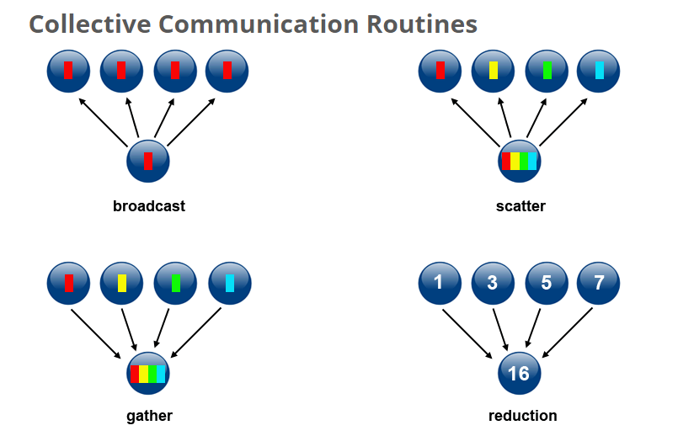
Collective Communications

Slide 45



MPI_Bcast (one-to-all)
MPI_Bcast(void *buffer, int count, MPI_Datatype datatype, int root, MPI_Comm comm)
Broadcasts a message from process with rank root in comm to all other processes in comm.
One process (root) sends data to all the other processes in the same communicator
Must be called by all the processes with the same arguments Data
Root
Data
Process
Process
Process
Process
buffer → starting address of buffer
count → number of entries in buffer (integer)
datatype → data type of buffer
root → rank of broadcast root (integer)
comm → communicator (handle)

Slide 46
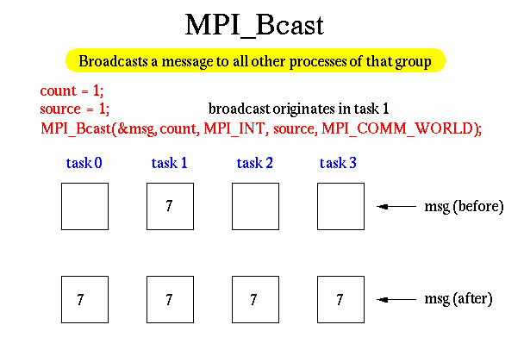

Slide 47

MPI_Reduce
MPI_Reduce(void *sendbuf, void *recvbuf, int count, MPI_Datatype datatype,
MPI_Op op, int root, MPI_Comm comm)
One process (root) collects data from all the other processes in the same communicator, and performs an operation on the data (i.e combines elements provided by input buffer of each process in the group using operation op.)
Returns combined value in the output buffer of process with rank root
Operator
MPI_SUM
MPI_MAX
MPI_MIN
MPI_PROD
Root
operator
Root
Process
Process
Process
sendbuf → address of send buffer
recvbuf → address of result buffer
count → number of elements in send buffer (integer)
datatype → data type of send buffer
op → reduction operation
root → rank of broadcast root (integer)

Slide 48
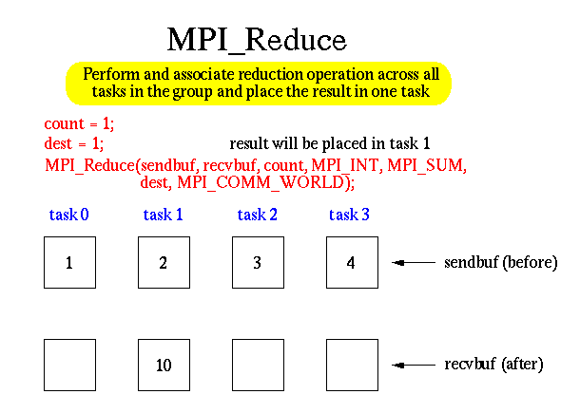

Slide 49





MPI_Scatter
MPI_Scatter (void *sendbuf, int sendcount, MPI_Datatype sendtype, void *recvbuf,
int recvcount, MPI_Datatype recvtype, int root, MPI_Comm comm)
Sends individual messages from the root process to all other processes
Inverse to MPI_Gather
sendbuf is ignored by all non-root processes
Root
Data Data
Data Data
Root
Process
Process
Process
sendbuf → address of send buffer (significant only at root)
sendcount → number of elements sent to each process (significant only at root)
sendtype → data type of send buffer elements (significant only at root)
recvcount → number of elements in receive buffer (integer)
recvtype → data type of receive buffer elements
sendtype → data type of send buffer elements (significant only at root)
root → rank of sending process (integer)

Slide 50
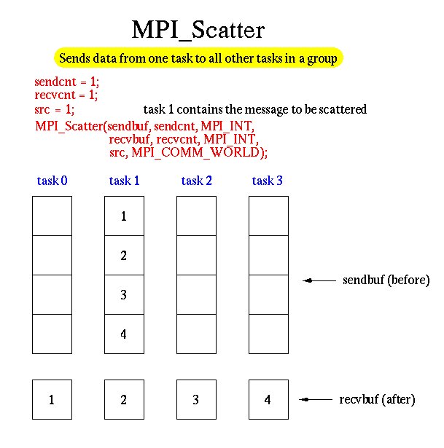

Slide 51
MPI_Gather
MPI_Gather (void *sendbuf, int sendcount, MPI_Datatype sendtype, void *recvbuf,
int recvcnt, MPI_Datatype recvtype, int root, MPI_Comm comm)
One process (root) collects data from all the other processes in the same communicator (i.e each process in comm (including root itself) sends its sendbuf to root.)
The root process receives the messages in recvbuf in rank order
Must be called by all the processes with the same arguments
Process
Data Data
Data Data
Root
Process
Process
Process
Inverse to MPI_Scatter

Slide 52
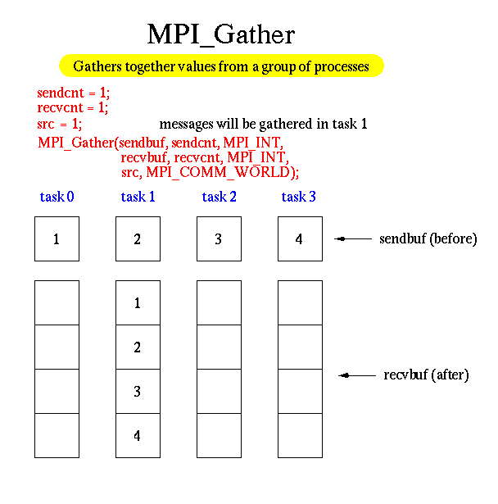

Slide 53


MPI_Allgather
MPI_Allgather (void *sendbuf, int sendcnt, MPI_Datatype sendtype, void *recvbuf,
int recvcnt, MPI_Datatype recvtype, MPI_Comm comm)
All the processes collects data from all the other processes in the same communicator (i.e similar to MPI_Gather except now all processes receive the result.)
recvbuf is NOT ignored
Must be called by all the processes with the same arguments
Root
Process
Process
Process
Process

Slide 54
MPI_Allgather
PO | A
P1 | B
P2 | C
P3 | D
PO | A | B | C | D
P1 | A | B | C | D
P2 | A | B | C | D
P3 | A | B | C | D

Slide 55
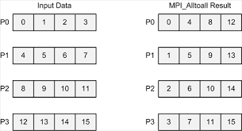
MPI_Alltoall
MPI_Alltoall (void *sendbuf, int sendcount, MPI_Datatype sendtype, void
*recvbuf, int recvcount, MPI_Datatype recvtyp, MPI_Comm comm )
It is a combination of MPI_Scatter and MPI_Gather
It is an extension of the MPI_Allgather function
Each process sends distinct data to each of the receivers. The j^{th} block that is sent from process i is received by process j and is placed in the i^{th} block of the receive buffer

Slide 56
MPI_Alltoall
PO | A0 | B0 | C0 | D0
P1 | A1 | B1 | C1 | D1
P2 | A2 | B2 | C2 | D2
P3 | A3 | B3 | C3 | D3
PO | A0 | A1 | A2 | A3
P1 | B0 | B1 | B2 | B3
P2 | C0 | C1 | C2 | C3
P3 | D0 | D1 | D2 | D3

Slide 57
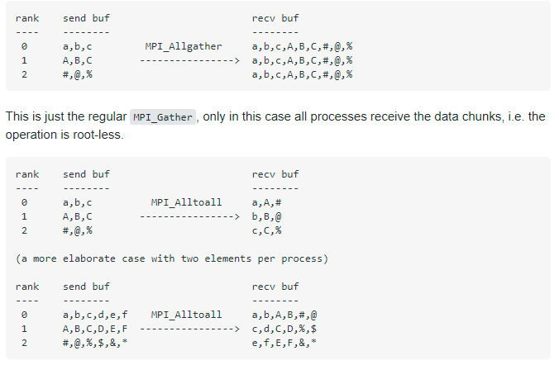
MPI_Allgather vs MPI_Alltoall

Slide 58
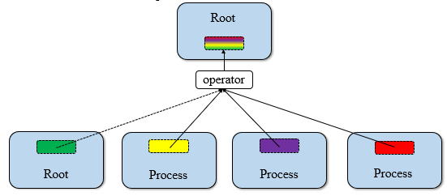
MPI_Scan
MPI_Scan (void *sendbuf, void *recvbuf, int count, MPI_Datatype datatype, MPI_Op op, MPI_Comm comm )
It returns the partial operation results on each processor
Process
Data Data
Data Data
Root
Process
Process
Process

Slide 59
MPI_Reduce vs MPI_Scan
A reduction means all processors get the same value while scan returns the partial operation results on each processor
For example:
if you had 10 processors and you were taking the sum of their rank, MPI_Reduce would give you the scalar 45 (0+1+2+3+4+5+6+7+8+9) on the root process,
while MPI_scan would give you the scalar of the reduction up to the rank of the processor on each processor. So processor 0 would get 0, processor 1 would get 1, processor 2 would get 3, and so on. Processor 9 would get 45

Slide 60
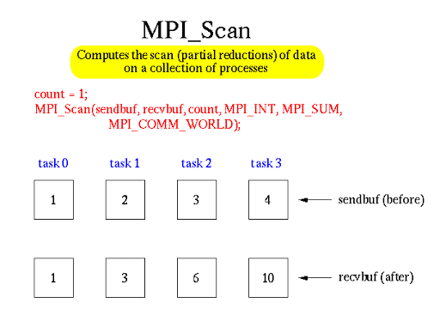

Slide 61
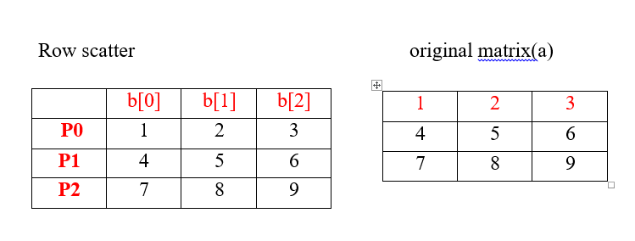

Slide 64
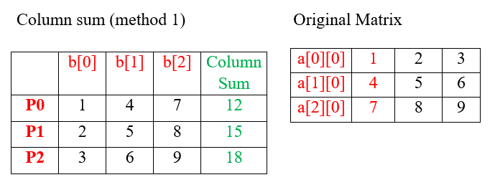

Slide 67
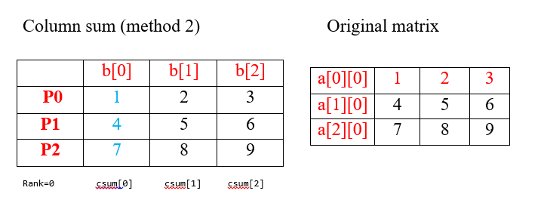

Slide 68
Benchmarking Parallel Performance
Benchmarking parallel program performance measure how well parallel programs perform against their sequential counterparts in the "middle area" between reading the dataset and writing the results
Typically, we are going to ignore the time spent initiating MPI processes, establishing communications sockets between them, and performing I/O on sequential devices
Reading data
Execution time
Benchmarking Performance
Display results

Slide 69
Benchmarking Parallel Performance
MPI provides a function called MPI_Wtime that returns the number of seconds that have elapsed since some point of time in the past
Function MPI_Wtick returns the precision of the result returned by MPI_Wtime
double MPI_Wtime (void)
double MPI_Wtick (void)
We can benchmark a section of code by putting a pair of calls to function MPI_Wtime before and after the section. The difference between the two values returned by the function is the number of seconds elapsed
double elapsed_time;
………….
MPI_Init(&argc, &argv);
elapsed_time = - MPl_Wtime();
…….parallel execution code…..
elapsed_time += MPI_Wtime();

Slide 70
Setting barrier for process synchronization
From a logical point of view, every MPI process begins execution at the same time, but this is not true in practice
MPI processes executing on different processors may begin executing seconds apart. This can throw off timings significantly
We address this problem by introducing a barrier synchronization before the first call to MPI_Wtime.
No process can proceed beyond a barrier until all processes have reached it
Hence a barrier ensures that all processes are going into the measured section of code at more or less the same time

Slide 71
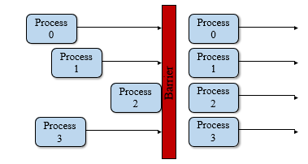
Setting barrier for process synchronization
MPI_Barrier(MPI_COMM_WORLD)
Process synchronization (blocking)
All processes are forced to wait for each other
Use only where necessary
Will reduce parallelism
double elapsed_time;
………….
MPI_Init(&argc, &argv);
MPI_Barrier (MPI_COMM_WORLD)
elapsed_time = - MPl_Wtime();
…….parallel execution code…..
elapsed_time += MPI_Wtime();

Slide 72
MPI Error Handling Functions
When an error is occurred while executing a MPI program typically, the program aborts
MPI calls a default error handler MPI_ERRORS_ARE_FATAL every time an MPI error is detected within the communicator
MPI_ERRORS_ARE_FATAL abort the whole parallel program as soon as any MPI error is detected
There is another predefined error handler MPI_ERRORS_RETURN which is used to return the generated error for custom handling
The default error handler MPI_ERRORS_ARE_FATAL can be replaced with MPI_ERRORS_RETURN by calling function MPI_Errhandler_set ()
MPI_Errhandler_set(MPI_COMM_WORLD, MPI_ERRORS_RETURN)

Slide 73
MPI Error Handling Functions
Once we’ve called MPI_Errhandler_set ( ) in our MPI code, the program will no longer abort on having detected an MPI error, instead the error will be returned and we will have to handle it
MPI standard defines error classes. Every error code, must belong to some error class, and the error class for a given error code can be obtained by calling function MPI_Error_class ()
Error code can be converted to comprehensible error messages by calling function MPI_Error_string ()
MPI_Error_class(int errorcode, int *errorclass)
MPI_Error_string(int errorcode, char *string, int *resultlen)

Slide 74
MPI Error Handling Functions
#include "mpi.h"
#include <stdio.h>
void ErrorHadler(int error_code);
int main(int argc,char *argv[]){
int C=3;
int numtasks, rank, len, error_code;
MPI_Init(&argc,&argv);
MPI_Errhandler_set(MPI_COMM_WORLD, MPI_ERRORS_RETURN);
MPI_Comm_rank(MPI_COMM_WORLD,&rank);
error_code = MPI_Comm_size(C,&numtasks);
ErrorHadler(error_code);
printf ("Number of tasks= %d My rank= %d \n", numtasks,rank);
MPI_Finalize();
}

Slide 75
MPI Error Handling Functions
void ErrorHadler(int error_code){
if (error_code != MPI_SUCCESS){
char error_string[BUFSIZ];
int length_of_error_string, error_class;
MPI_Error_class(error_code, &error_class);
MPI_Error_string(error_code, error_string, &length_of_error_string);
printf( "%d %s\n", error_code, error_string);
MPI_Error_string(error_class, error_string, &length_of_error_string);
printf("%d %s\n", error_class, error_string);
}
}

Slide 76
Useful MPI Routines
Routine | Purpose/Function
MPI_Init | Initialize MPI
MPI_Finalize | Clean up MPI
MPI_Comm_size | Get size of MPI communicator
MPI_Comm_Rank | Get rank of MPI Communicator
MPI_Reduce | Min, Max, Sum, etc
MPI_Bcast | Send message to everyone
MPI_Allreduce | Reduce, but store result everywhere
MPI_Barrier | Synchronize all tasks by blocking
MPI_Send | Send a message (blocking)
MPI_Recv | Receive a message (blocking)
MPI_Isend | Send a message (non-blocking)
MPI_Irecv | Receive a message (non-blocking)
MPI_Wait | Blocks until message is completed

Slide 77
MPI Documentation MPI Reference

